Slide 1

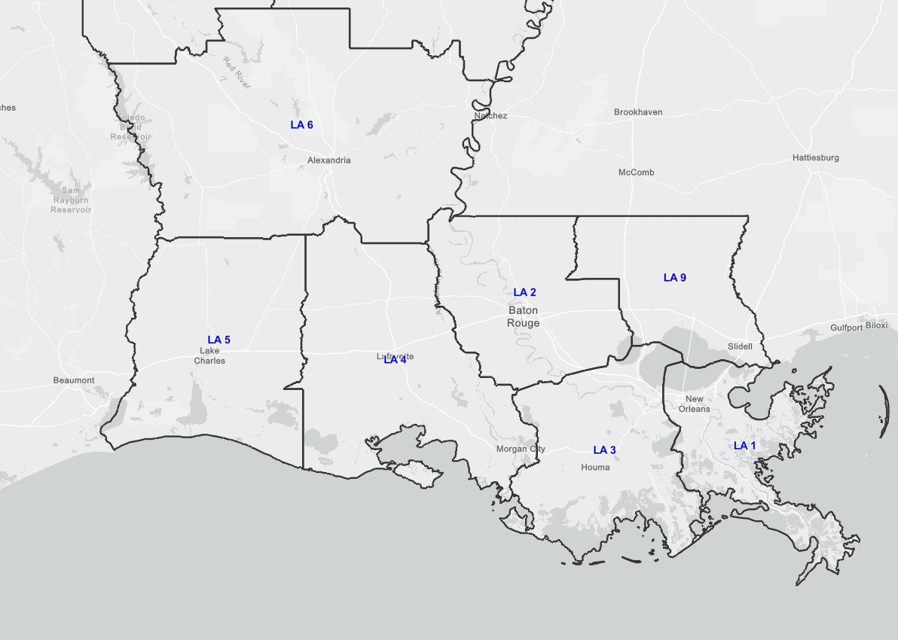
US&R Force Laydown for Hurricane Ida
FEMA White IST
September 4, 2021
0700 HRS
FEMA
CO-TF1 T3 (45 pax)
MA-TF1 T1 (80 pax)
MD-TF1 T3 (45 pax)
SUSAR
IL-TF1 T3 (43 pax)
MI-TF1 T3 (44 pax)
OH-TF2 SWR T1 (22 pax)
SC-TF1 SWR T1 (17 pax)
Terrebonne
Grand Isle
Notes:
09/04/21
Excessed
LA3
NV
NY
Div 3
MA
MD
CO
MI
IL
SC
OH

Slide 2
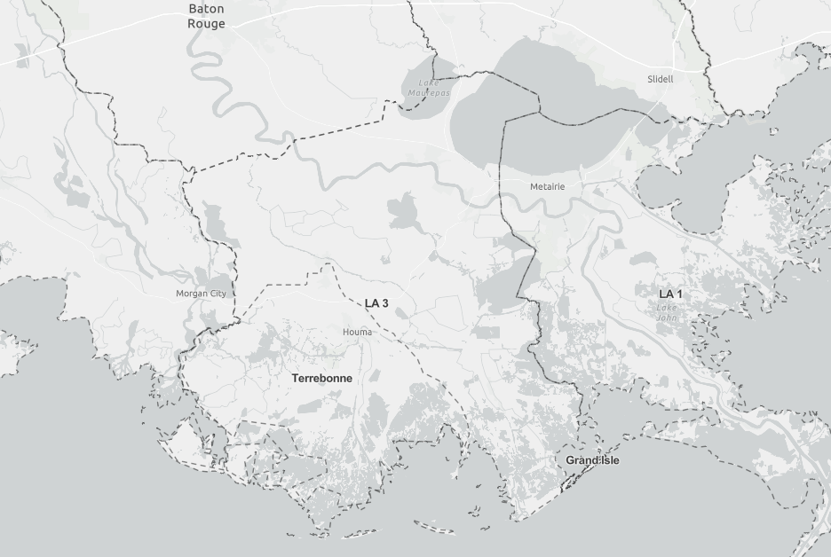
US&R Force Laydown for Hurricane Ida
FEMA White IST
September 3, 2021
2115 HRS
FEMA
VA-TF2 T3 (45 pax)
TX-TF1 T1 (80 pax)
OH-TF1 T3 (45 pax)
SUSAR
IL-TF1 T3 (43 pax)
LA-TF2 T3 (35 pax)
TN-TF2 T3 (36 pax)
OK-TF1 T3 (32 pax)
OK-TF2 T3 (46 pax)
FEMA
CO-TF1 T3 (45 pax)
MA-TF1 T1 (80 pax)
MD-TF1 T3 (45 pax)
SUSAR
IL-TF1 T3 (43 pax)
MI-TF1 T3 (44 pax)
OH-TF2 SWR T1 (22 pax)
SC-TF1 SWR T1 (17 pax)
FEMA
NV-TF1 T3 (45 pax)
SUSAR
LA-TF3 T4 (36 pax)

